Slide 1
Customer churn – Financial Services
Melissa Russell, Jonathan Voth, & Nick Wawee

Slide 2
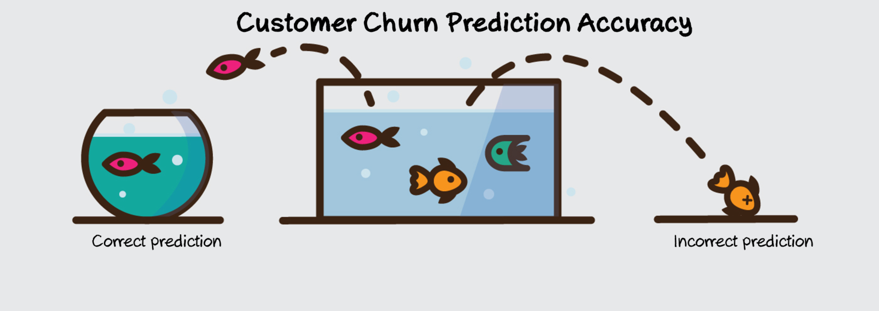
Introduction
Predictions:
Neural network, Random Forest, & ADABoost models will successfully predict customer churn.
Age, marital status, and income will be the most significant features in predicting customer churn.
Problem: Customer Churn
Primary Goal: Fit model(s) to the data that will successfully predict if a customer will churn or not.
Secondary Goal: Determine which features are most significant in predicting customer churn.

Slide 3
Dataset: Credit Card Customers
Name | Data Type | Type | Description
Attrition_Flag | Categorical (2, 16% Flagged) | Response | Did the customer leave?
Customer_Age | Integer | Feature | Age in years
Gender | Categorical (2) | Feature | Male or Female
Dependent_Count | Integer | Feature | How many dependents the customer has
Education_Level | Categorical (4) | Feature | How educated the customer is
Marital_Status | Categorical (3) | Feature | Marital Status
Income_Category | Categorical (4) | Feature | Income Bracket
Card_Category | Categorical (4) | Feature | What kind of card the customer posses
Months_on_book | Integer | Feature | How long the customer has had a relationship with the bank
Total_Relationship_Count | Integer | Feature | Total number of products a customer has
Months_Inactive_12_mon | Integer | Feature | Number of inactive months within the last 12
Contacts_Count_12_mon | Integer | Feature | How frequent the customer contacted the bank in the last 12 months
Credit_Limit | Integer | Feature | Credit limit in $
Total_Revolving_Bal | Integer | Feature | Total balance
Avg_Open_To_Buy | Integer | Feature | Limit - Balance
Total_Amt_Chng_Q4_Q1 | Float | Feature | Change in transaction amount in Q4/Q1
Total_Trans_Amt | Integer | Feature | Total transaction amount
Total_Ct_Chng_Q4_Q1 | Float | Feature | Change in transaction count in Q4/Q1
Avg_Utilization_Ratio | Float | Feature | Balance / Limit
Retrieved from Kaggle.com
~10,000 customers of a bank
Response variable is attrition_flag – if the customer has left or not
16.07% of customers have churned
18 features

Slide 4
Methods
Preprocess and clean the data
Remove unknown values and card category feature
Response variable contained 15.7% customer attrition
Partition data 70:30
Logistic regression, classification tree, nearest neighbor, and neural network
Ensemble methods (Random Forest and ADABoost)
Under-sampling was used to address the uneven distribution in the response variable
Evaluation metrics: accuracy, kappa, sensitivity, and specificity
Focus on sensitivity as customer attrition was considered “positive”

Slide 5
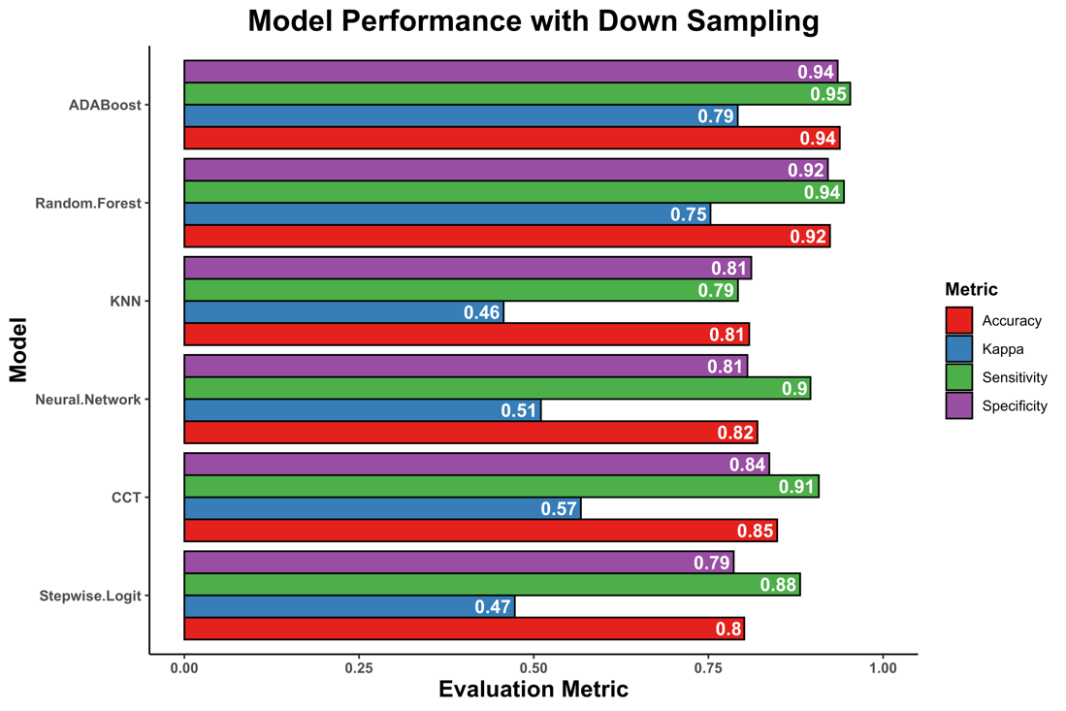
Results – Performance Metrics
Under sampled models were chosen because of they had overall a better performance
ADABoost and Random Forest performed the best
Sensitivity and Specificity in the mid-90th percentile
Stepwise logistic regression used to interpret customer attributes relationship to attrition

Slide 6
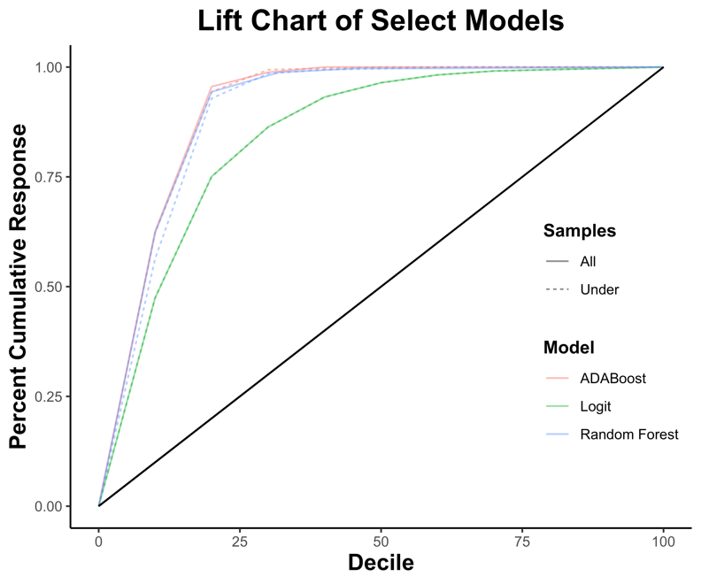
Lift Chart Performance
Down sampling had little impact on performance
Ensemble tree models clearly outperforms the logit model
Tree model: Top 25%
Logit: Top 60%
Ensembles would aid in decreasing marketing costs

Slide 7
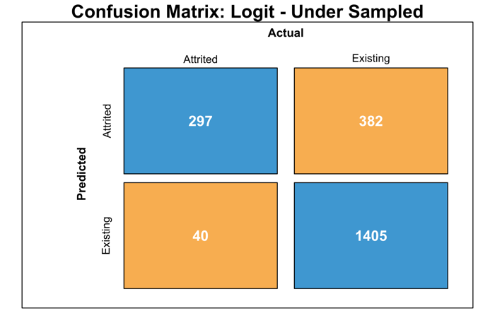
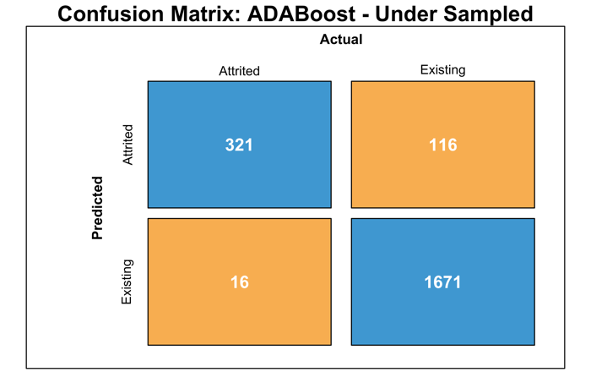
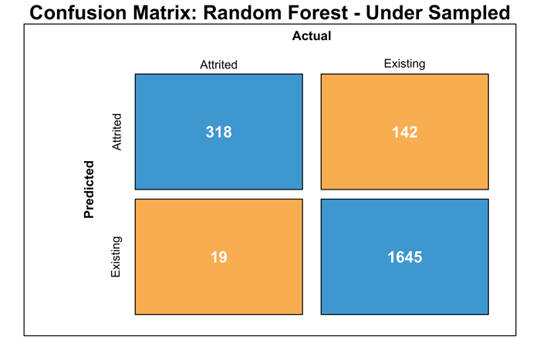
Confusion Matrices
Low number of FN in comparison to TP ➔ high sensitivity
Low number of FP in comparison to TN ➔ high specificity
Logit model has twice the number of false negatives and positives
ADABoost Optimal Parameters:
Iterations = 150
Maximum Tree Depth = 6
Learning Rate = 0.15
RF Optimal Parameters:
Number of Predictors = 8
Number of Trees = 50

Slide 8
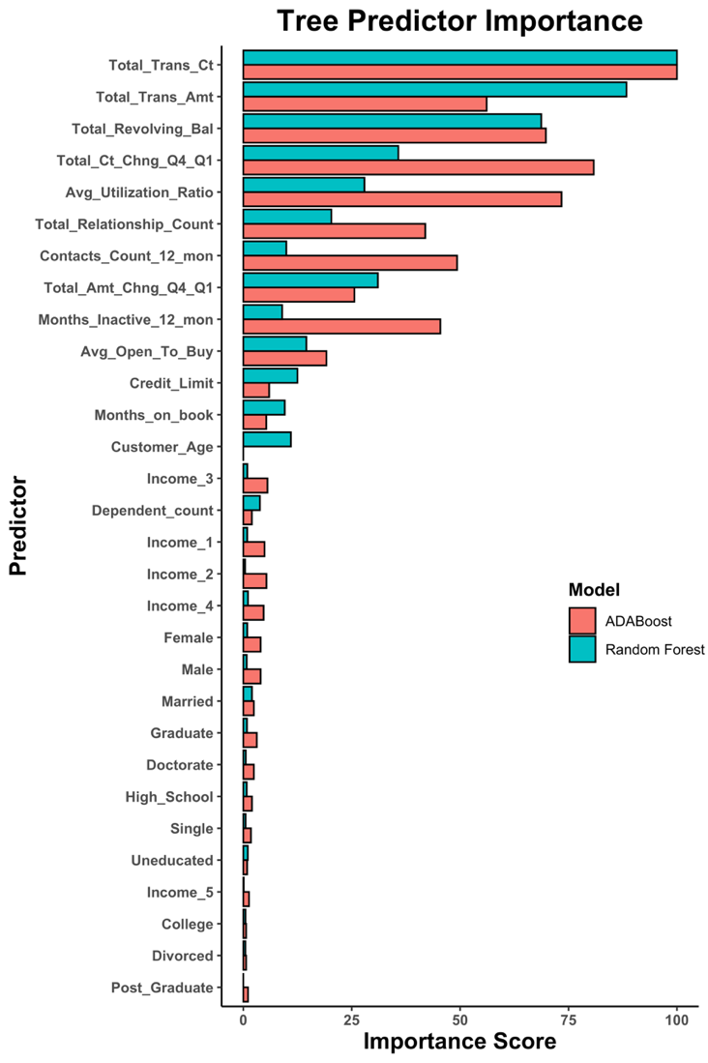
Ensemble Variable Importance
Total transaction Number and Amount, Revolving Balance ➔ Most Important
Several variables are more important in ADABoost compared to RF
Age is somewhat important in RF but not in ADABoost

Slide 9
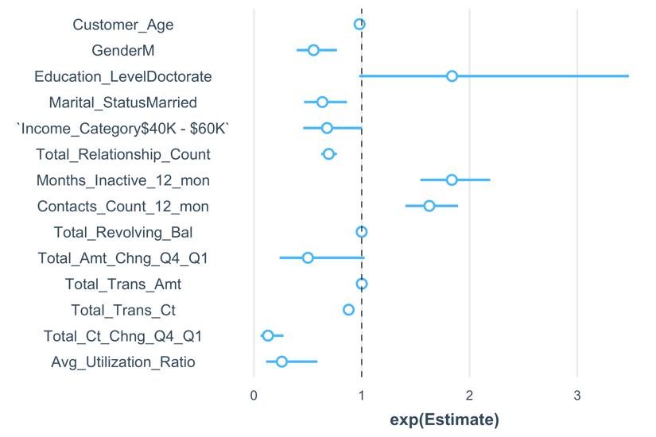
Logit Variable Impact
Inactivity within the past twelve months and total transaction amount increase odds ratio (OR) of attrition to existing
Characteristics that decrease OR
Transaction count ratio Q4/Q1
Balance / Limit
Male Gender
Married Customer
Total # Products
Total # of Transactions
Four predictors that had questionable significance
Total Amount Change Q1 – Q4
Doctorate Education Level
$40K - $60K Income category
Customer Age
Attrited Customer = 1, Existing Customer = 0

Slide 10
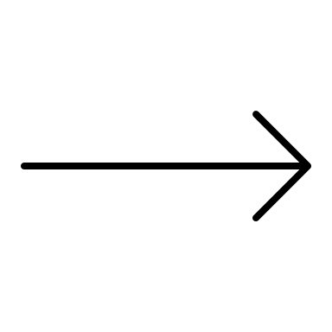
Discussion
Predictions:
Neural network, Random Forest, & ADABoost models will successfully predict customer churn.
Age, marital status, and income will be the most significant features in predictingcustomer churn.
Results:
Neural network, Random Forest, & ADABoost models all successfully predict customer churn.
NN Sensitivity: 0.90
RF Sensitivity: 0.94
ADA Sensitivity: 0.95
The number of transactions and amount of transactions are the most significant features in predicting customer churn.

Slide 11
Limitations & Future Work
Limitations:
Lack of context, did not know about data collection process and which bank it came from
More features– some additional customer attributes may be more telling such as automatic debit transfers
Future Work:
Clustering analysis of attrited customers to define their characteristics
Dimensionality reduction prior to model fit
Usage of advanced down sampling (ENN) or oversampling techniques (SMOTE)
Generate profit models by simulating marketing costs and profit per customer

Slide 12


THANK you! Questions?
Code Publicly Available:
https://gitlab.com/nickwawee/customer_churn
https://github.com/nickwawee/customer_churn

